Slide 1
PRESENTATON
ON
SMTP
GROUP 4
ALMORA RAZIA KHARKAMNI
MELBOREEN WARBAH

Slide 2
CONTENT
Introduction
Format of an email
Basic SMTP Architecture
SMTP Communication Model
Commands of SMTP
Session Establishment and Termination
SMTP Mail Transaction Process
Status Codes
Advantages
Limitation
Special Features
References

Slide 3
INTRODUCTION
SMTP stands for Simple Mail Transfer Protocol.
MTP preceded SMTP. The Commands of MTP are based directly on those of FTP.
Came into existence in 1981 (RFC 780)
SMTP is simpler than MTP it replaced.
When an e-mail is sent from the sender to receiver, in most cases this involves, the sender machine sends the email to local SMTP sever, which in then sends mail to recipients local SMTP sever, and finally to recipients local machine.

Slide 4
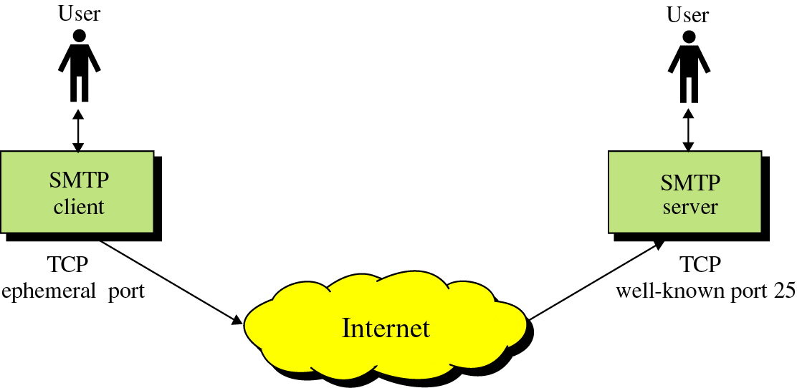
SMTP
Protocol originated in 1982 (RFC821, Jon Postel)
Standard message format (RFC822,2822, D. Crocker)
Goal: To transfer mail reliably and efficiently

Slide 5
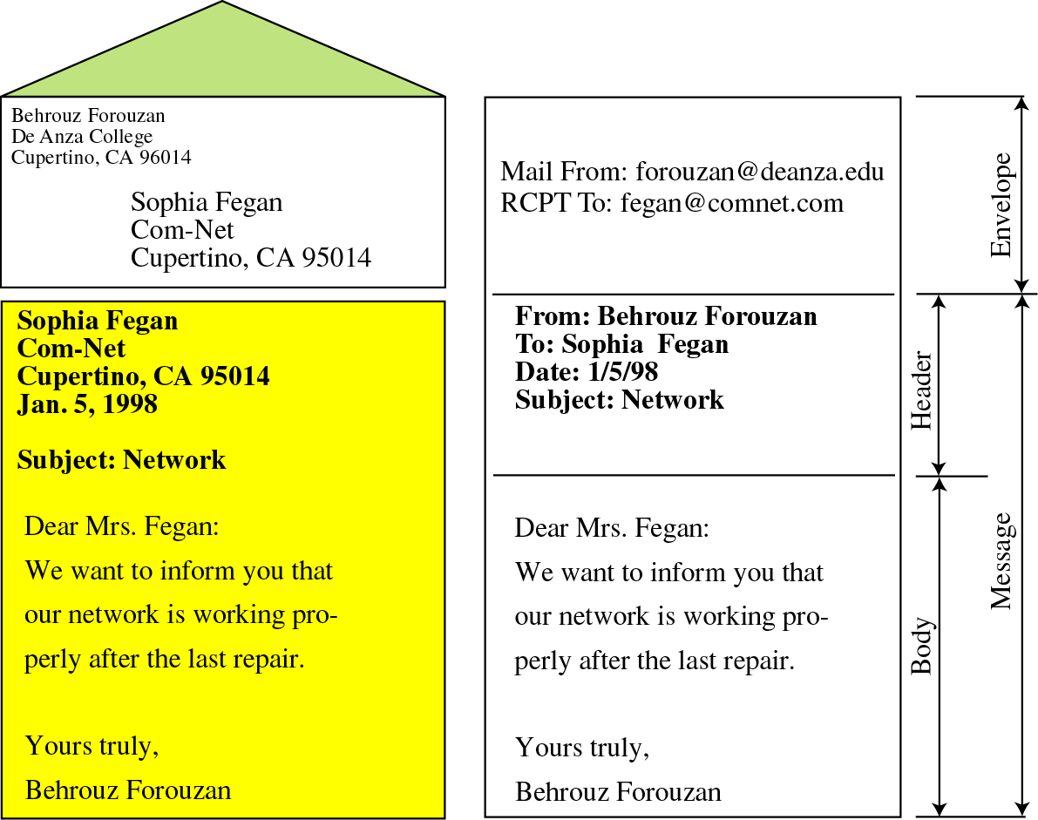
Format of an email
Mail is a text file
Envelope –
sender address
receiver address
other information
Message –
Mail Header – defines the sender, the receiver, the subject of the message, and other information
Mail Body – Contains the actual information in the message

Slide 6
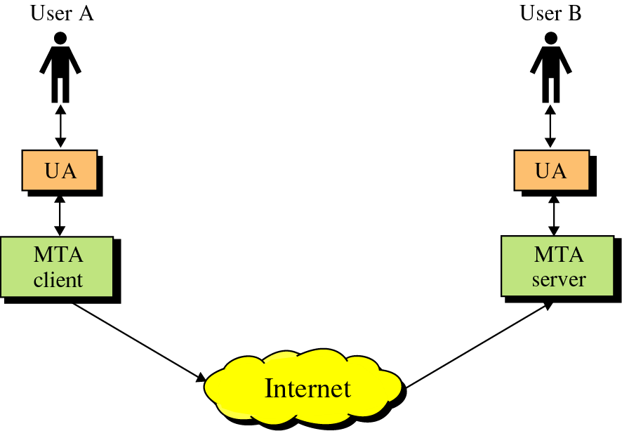
Basic SMTP Architecture
SMTP clients and servers have two main components
User Agents – Prepares the message, encloses it in an envelope. (ex. Thunderbird, Eudora)
Mail Transfer Agent – Transfers the mail across the internet (ex. Sendmail, Exim)
Analogous to the postal system in many ways
User Agents
Mail Transfer Agents

Slide 7
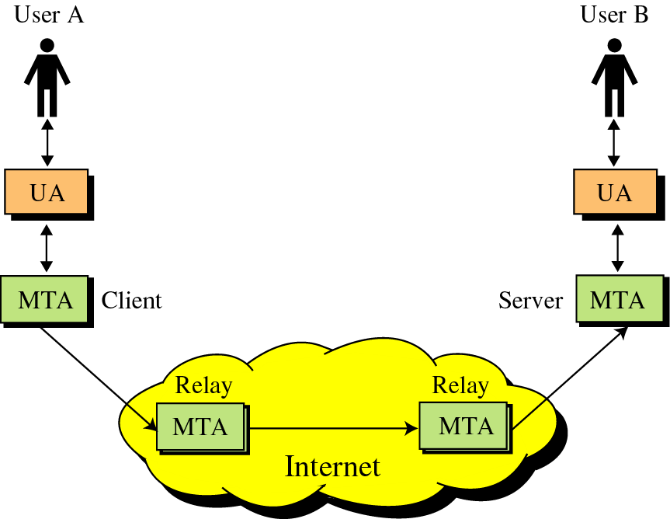
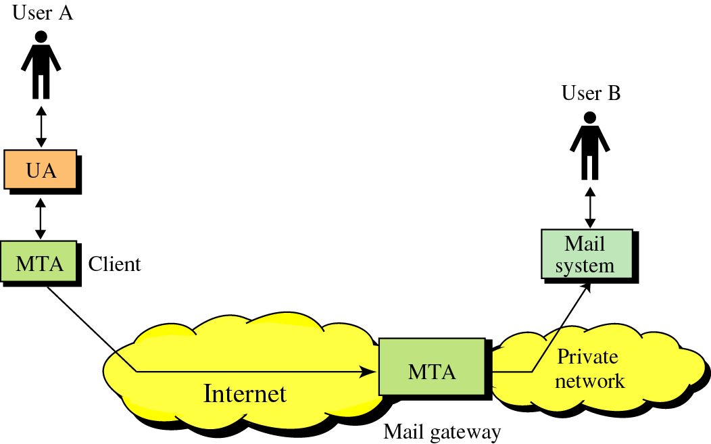
SMTP
SMTP also allows the use of Relays allowing other MTAs to relay the mail
Mail Gateways are used to relay mail prepared by a protocol other than SMTP and convert it to SMTP

Slide 8
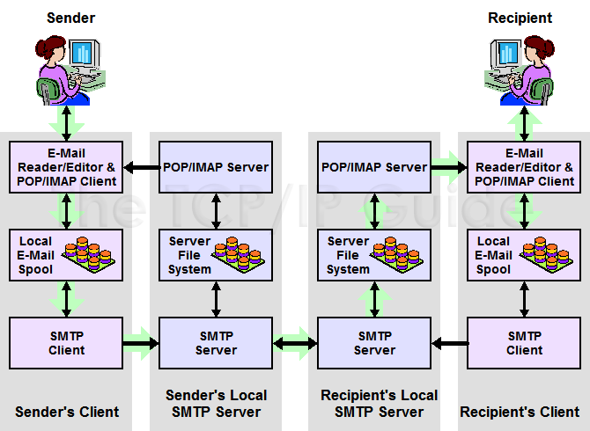
SMTP Communication Model

Slide 9
Commands of SMTP
HELO : Request to initiate SMTP session
MAIL FROM : Sender’s E-Mail address
RCPT TO : Receiver’s E-Mail address
DATA : Body of message
QUIT : Terminates SMTP connection
RSET : Aborts mail transaction
VRFY : Asks receiver to verify the validity of the mailbox
EXPN : Asks receiver to identify mailing list
HELP : Causes receiver to send help information
NOOP : Forces server to verify the communication with SMTP
receiver

Slide 10
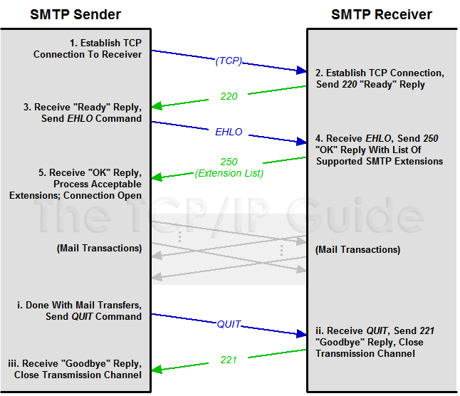
Session Establishment and Termination

Slide 11
SMTP Mail Transaction Process
1. Transaction Initiation and Sender Identification
S: HELO sjsu.edu
R: 250 Hello sjsu.edu S: MAIL FROM:<cooldd10@yahoo.com> R: 250 Ok
2. Recipient Identification
S: RCPT TO:<jainip_1983@gmail.com> R: 250 Ok
3. Mail Transfer
S: DATA R: 354 End data with <CR><LF>.<CR><LF> S: <The message data>
S:. R: 250 Ok, message accepted for delivery: queued as 12345 S: QUIT R: 221 Bye

Slide 12
Status Codes
The Server responds with a three digit code that may be followed by
the text info.
2XX – The SMTP server has accepted the command and has completed the request.
3XX - Command is accepted and more information follows.
4XX - Try again later as there was a temporary failure with the command or the server.
5XX – The requested operation will never be completed due to permanent error.

Slide 13
Advantages
Very Popular
Supported on many platforms
Low administration and implementation costs
Simple addressing scheme

Slide 14
Limitations
Security matters for SMTP are worse.
Its usefulness is limited by its simplicity.
Transmission of executable files and binary files using SMTP is not possible without converting into text files. Use MIME to send mail in other format.
It cannot transmit text data that contains national language characters. These national language characters use 8-bit codes with values of 128 decimal or more.
It is limited to 7-bit ASCII characters only.
SMTP servers may reject mail messages beyond some specific length.

Slide 15
Special Features
Mail Forwarding: SMTP server may agree to accept e-mail for non-local mailbox and forward it to the appropriate destination.
Mail Gatewaying: SMTP servers can be implemented as e-mail gateways which can translate TCP/IP email in a suitable form for some another e-mail system and vice-versa.
Mail Relaying: SMTP includes the ability to relay mail from one server to another, as explained earlier, provided certain conditions are met.
Address Debugging: VRFY command allows the client to ask the sender to verify address of recipient without sending mail to recipient.
Mailing List Expansion: EXPN command allows to expand mailing list.

Slide 16
References
Web Sites:
http://www.faqs.org/rfcs/rfc821.html (RFC 821).
http://www.faqs.org/rfcs/rfc2821.html (RFC 2821)
http://www.tcpipguide.com/free/t_SMTPSpecialFeaturesCapabilitiesandExtensions.html
http://cns.utoronto.ca/usg/technotes/smtp-intro.html
http://computer.howstuffworks.com/email5.htm
Books:
Programmer's Guide to Internet Mail by John Rhoton
TCP/IP Illustrated Volume 1 by Richard Stevens

Slide 17
THANK YOU

